Slide 1

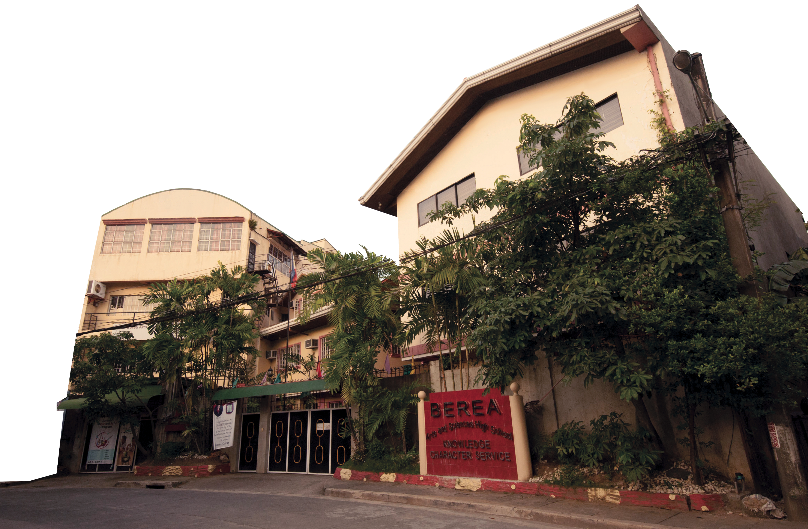


Arts Department Meeting
July 10, 2025
Arts Department
First Quarter
SY 2025-2026

Slide 2
Check-In
How are classes?
Any issues?
Arts Department
First Quarter
SY 2025-2026

Slide 3
Review of work
Curriculum Map (HS only)
Course Outline
Lesson Plan
Classroom Instruction
Assessment
Grading
Arts Department
First Quarter
SY 2025-2026

Slide 4
Review of work
Lesson Plan
Submitted every Saturday
Upload to Google Drive folder* then link in Teachers’ Log 2025-26 Arts Department SY 2025-2026>Name>Subject>Q1
No week 2
*see Arts Department folder
Arts Department
First Quarter
SY 2025-2026

Slide 5
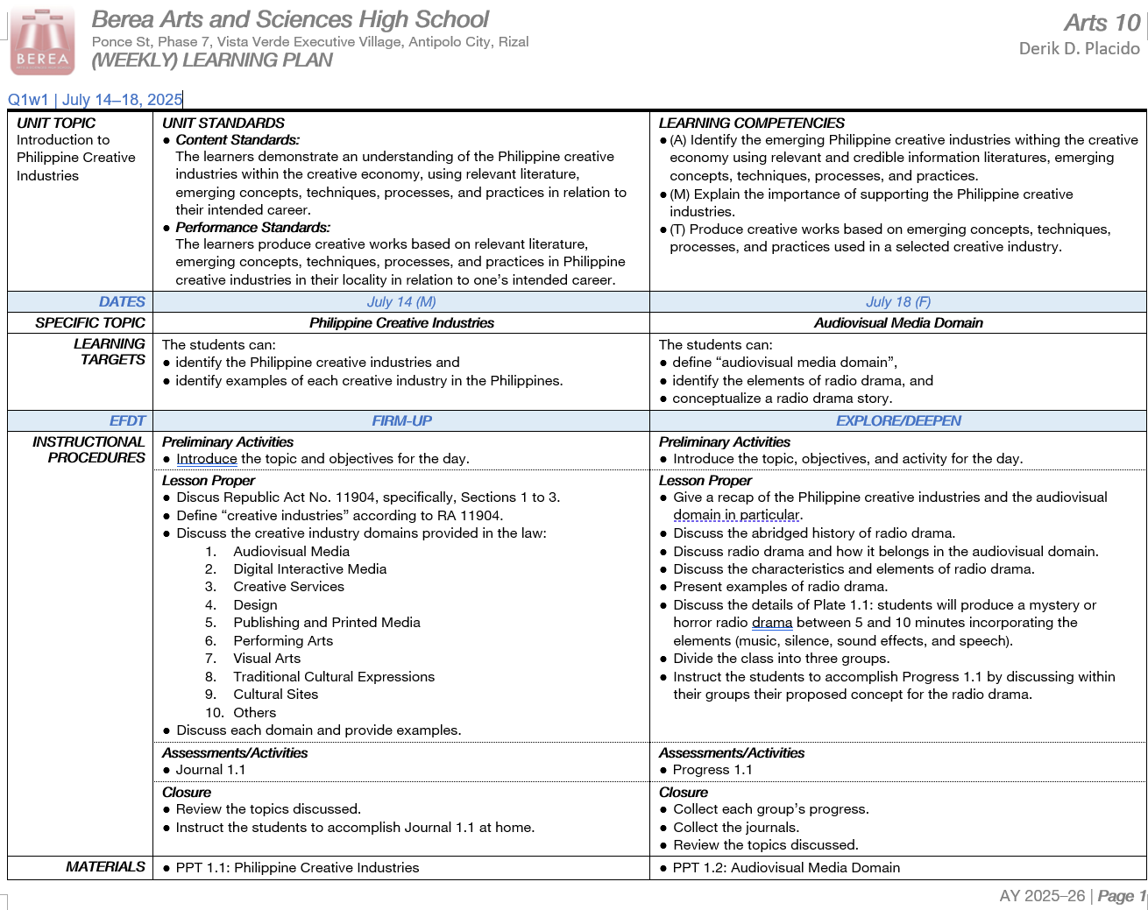
Arts Department
First Quarter
SY 2025-2026

Slide 6
Review of work
Classroom Instruction
Introduce topic, objectives, and activity
Discuss topics
Check materials
Give detailed instructions for the activity (Progress) posted on Google Classroom
Monitor and give assistance
Grade progress in record book
Instruct to write journal (Journal) in their notebook
Arts Department
First Quarter
SY 2025-2026

Slide 7
Review of work
Assessment*
Plate (20%)
Progress (25%)
Journal (20%)
Class Participation (15%)
Final Plate (20%)
*see Art Assessments
Arts Department
First Quarter
SY 2025-2026

